Slide 1
Substitution Techniques CAESER CIPHER
In a Substitution cipher, any character of plain text from the given fixed set of characters is substituted by some other character from the same set depending on a key. For example with a shift of 1, A would be replaced by B, B would become C, and so on.
Mathematical representation
The encryption can be represented using modular arithmetic by first transforming the letters into numbers, according to the scheme, A = 0, B = 1,…, Z = 25. Encryption of a letter by a shift n can be described mathematically as.

Slide 2
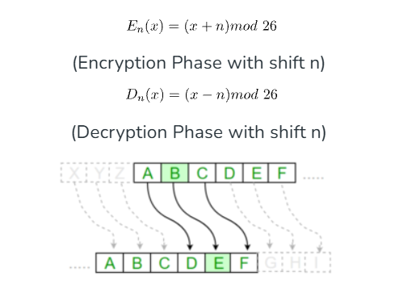
Substitution Cipher

Slide 3
EXAMPLE
Plain Text: ABCDEFGHIJKLMNOPQRSTUVWXYZ Key: 4 Output: EFGHIJKLMNOPQRSTUVWXYZabcd

Slide 4
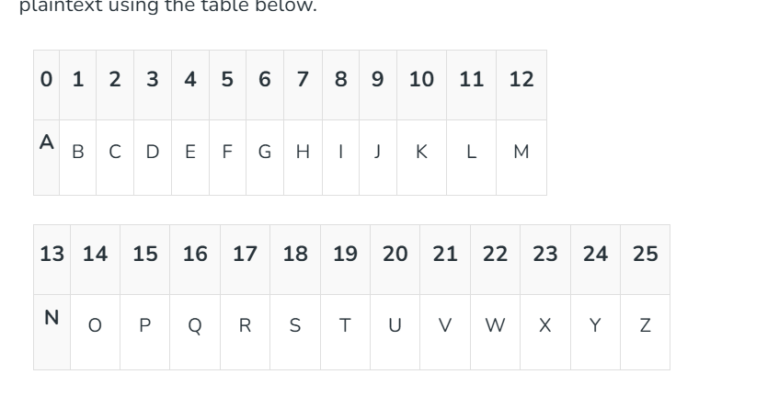
Mono-alphabetic cipher

Slide 5
Advantages of Monoalphabetic Cipher
Better Security than Caesar Cipher.
Provides Encryption and Decryption to data.
Monoalphabetic Cipher maintains a frequency of letters.
Disadvantages of Monoalphabetic Cipher
Monoalphabetic ciphers are easy to break because they reflect the frequency data of the original alphabet.
Prone to guessing attack using the English letters frequency of occurrence of letters.
The English Language is used so the nature of plain text is known.
Less secure than a polyalphabetic cipher.

Slide 6
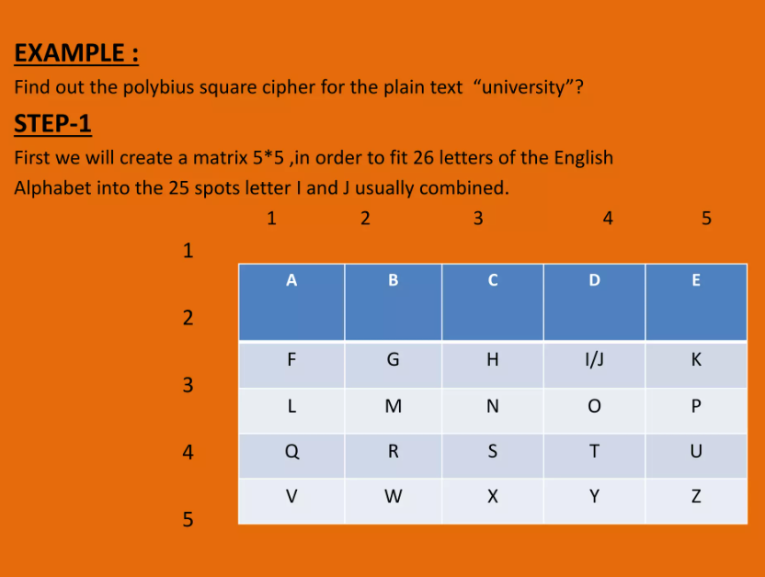
Homophonic substitution cipher

Slide 7
Example of Homophonic Substitution Cipher
A homophonic substitution cipher allows one plaintext letter to have multiple possible ciphertext symbols. This helps hide the frequency of common letters such as E, T, A, etc.
Plaintext Letter | Possible Cipher Symbols
A | 12, 45
B | 07
E | 18, 31, 64
H | 22
L | 09, 53
O | 27, 71
T | 14, 38

Slide 8
Ciphertext
HELLOAT HOME → 22 31 53 09 71 45 14 22 27 06 64
Why is it called "Homophonic"?
Notice that E has several possible ciphertexts:
E → 18 OR 31 OR 64
Similarly:
L → 09 OR 53
So, the same plaintext letter can be represented by different ciphertext symbols.
Simple definition:
Homophonic substitution cipher = one plaintext letter → multiple possible ciphertext symbols.

Slide 9
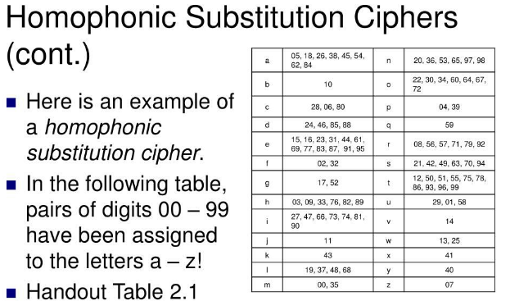

Slide 10
Polygram substitution cipher
ABC➔WXY
PQR➔HJI
ABCPQR➔WXYHJI

Slide 11
EXAMPLE
Suppose we want to encrypt the statement:
“MEET ME AT THE PARK”
For a 3-letter polygram substitution, remove spaces and divide the message into groups of three:
MEETMEATTHEPARK
→ MEE | TME | ATT | HEP | ARK

Slide 12
Plaintext Polygram | Ciphertext Polygram
MEE | QXZ
TME | LKP
ATT | WNR
HEP | BGT
ARK | YHJ

Slide 13
Transposition Cipher Technique
The Transposition Cipher Technique is an encryption method used to encrypt a message or information.
This encryption method is done by playing with the position of letters of the plain text.
The positions of the characters present in the plaintext are rearranged or shifted to form the ciphertext.
It makes use of some kind of permutation function to achieve the encryption purpose.
It is very easy to use and so simple to implement.

Slide 14
Types of Transposition Cipher Techniques
There are three types of transposition cipher techniques
Rail Fence Transposition Cipher
Block (Single Columnar) Transposition Cipher
Double Columnar Transposition Cipher

Slide 15
Rail Fence Transposition Cipher
Rail Fence Transposition cipher technique is the simplest transposition cipher its.
It is also termed as a zigzag cipher.
It gets its name from the way through which it performs encryption of plain text

Slide 16
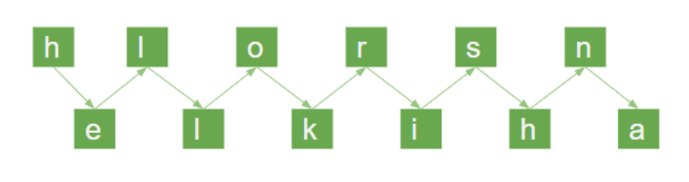
Technique of Rail Fence Transposition Cipher
Example: The plain text is "Hello Krishna"
Now, we will write this plain text in the diagonal form:
Cipher Text = “hlorsnelkiha"

Slide 17
Block (Single Columnar) Transposition Cipher
Block Transposition Cipher is another form of Transposition Cipher which was used to encrypt the message or information. In this technique, first, we write the message or plaintext in rows. After that, we read the message column by column. In this technique, we use a keyword to determine the no of rows.
Step 1: First we write the message in the form of rows and columns, and read the message column by column.
Step 2: Given a keyword, which we will use to fix the number of rows.
Step 3: If any space is spared, it is filled with null or left blank or in by (_).
Step 4: The message is read in the order as specified by the keyword.

Slide 18
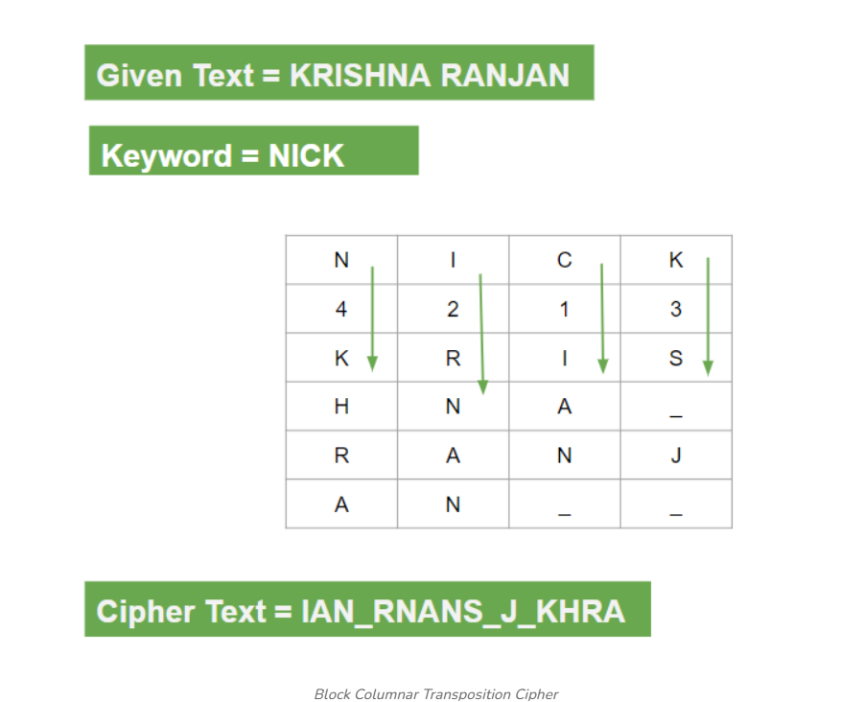

Slide 19
For example:
The plaintext is "KRISHNA RANJAN"
Now we will write the plaintext in the form of row and column.
Cipher Text = IAN_RNANS_J_KHRA

Slide 20
Vernam Cipher in Cryptography
Vernam Cipher is a method of encrypting alphabetic text. It is one of the Substitution techniques for converting plain text into cipher text. In this mechanism, we assign a number to each character of the Plain-Text, like (a = 0, b = 1, c = 2, ... z = 25).
Method to take key: In the Vernam cipher algorithm, we take a key to encrypt the plain text whose length should be equal to the length of the plain text.

Slide 21
Encryption Algorithm
Assign a number to each character of the plain text and the key according to alphabetical order.
Bitwise XOR both the number (Corresponding plain-text character number and Key character number).
Subtract the number from 26 if the resulting number is greater than or equal to 26, if it isn't then leave it.

Slide 22
Example
Plain-Text: O A K Key: S O N
O ==> 14 = 0 1 1 1 0 S ==> 18 = 1 0 0 1 0 Bitwise XOR Result: 1 1 1 0 0 = 28
Since the resulting number is greater than 26, subtract 26 from it. Then convert the Cipher-Text character number to the Cipher-Text character.
28 - 26 = 2 ==> C CIPHER-TEXT: C

Slide 23
Similarly, do the same for the other corresponding characters,
PT: O A K NO: 14 00 10 KEY: S O N NO: 18 14 13
New Cipher-Text is after getting the corresponding character from the resulting number.
CT-NO: 02 14 07 CT: C O H

Slide 24
Book Cipher
A book cipher is a method of encryption where words or letters in a secret message are replaced by numbers or codes that point to specific locations—such as page, line, or word numbers—within a shared reference book. Both sender and receiver must use the exact same book and edition.
How It Works
Shared Key: Both people own an identical copy of a book.
Coordinates: Each word or letter of the secret text is swapped for a set of numbers.
Example: Code [45, 2, 5] tells the reader to look at page 45, line 2, and word 5 to find the real letter or word.
Decoding: The receiver reverses the process by looking up each coordinate in their copy of the book to read the hidden message

Slide 25
Pros and Cons
Stealth: The secret message looks like random numbers, and the key is an ordinary book that does not arouse suspicion.
Security Risk: If intercepted, a book cipher can be cracked with frequency analysis if large amounts of text are sent, or if the specific book is identified.
Physical Dependency: Both parties must have secure access to the exact same physical or digital publication

